Slide 1
NSBE 2nd General Body Meeting
Agenda
Group Activity
Announcements
Reminder
“Keep it Real” Card game

Slide 2
NSBE Mission
“To increase the number of culturally responsible black engineers to excel academically, succeed professionally, and positively impact the community”

Slide 3
Announcements
September birthdays
Patrice Oseni
Nancy Smith
NSBE first Social Night
September 14th @ the Student Center Game room from 7pm to 12pm
Birthday cake, games, snacks, pool table

Slide 4
Announcements
Academic Excellence
Review Sessions for Calc I & Cal II
Wednesday Calc II review session TAC 208 at 8:30PM
Thursday Calc I review session TAC 206 at 8PM
Study sessions
Tuesday, Thursday, Sunday Science center 166 8PM-11PM

Slide 5
Announcements
Clarkson Diversity Networking Reception
Greet, converse, and get information on what companies are looking for; no resume needed
GE Energy’s interest in NSBE
“…if you are interested we would love to send you our job postings for you to disseminate to your NSBE members so they can make sure to apply to the jobs they are interested in ahead of time and that way we can make sure to meet them when we will be on campus.”

Slide 6
Reminder
Become a paid NSBE member…why???
First 12 people to pay their $25 National + Chapter dues will be offered:
Dinner at Vicki’s house-3 members
Free trip to Oswagachie-3 members
Free tickets to see Dr. Cornel West-6 members
First come first serve- You can start paying TODAY

Slide 7
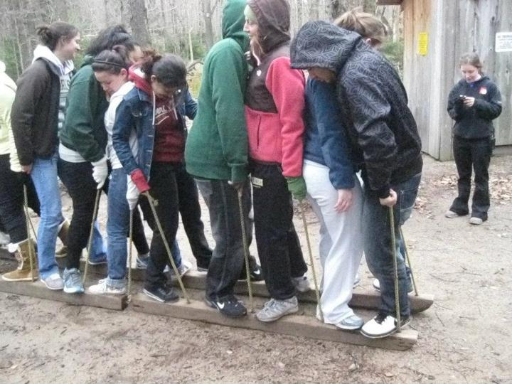
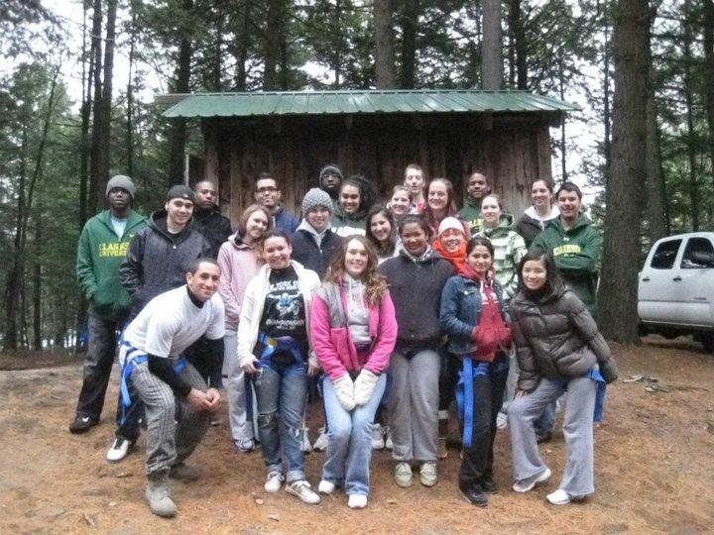
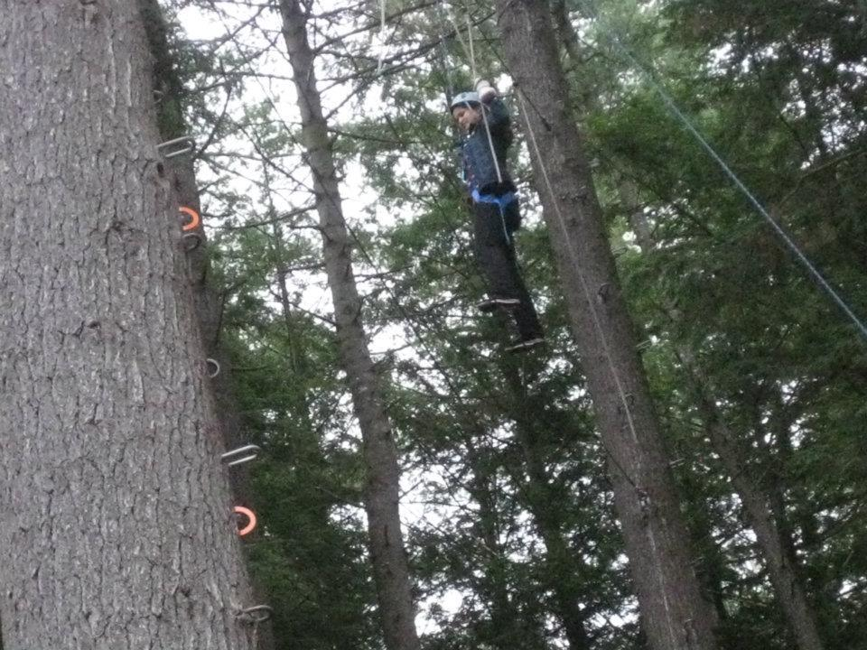
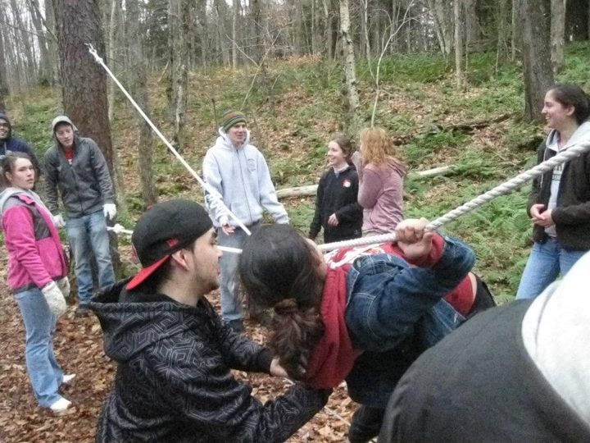
Oswagachie

Slide 8
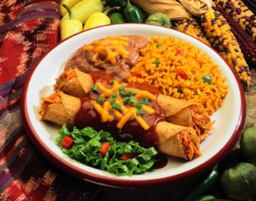
Group Activity
One of the things in life worth paying money for is good food. Too bad we are not providing you with food like this, but tell us what you want to get from NSBE that you feel will make your money worth it.
What is this doing here??
Professional-Career Building
Leadership Experience
Academic Performance
Personal/Social Development
3
4 categories
1
4
2

Slide 9
Professionalism
Career Fair Workshop
How to find summer research/internship workshop
Career Fair at Regional and National Conferences
Mentorship program-Mentors help their mentee find summer opportunities
Resume workshops
?Mock Interview?-Tentative

Slide 10
Leadership
Join Committees
Learn time management
Join Executive Board
Develop decision-making and problem solving skills
Learn to guide and direct
Lead group activities
Become innovative and outspoken
Hold General Body meetings
Challenge your comfort zone
Freshmen meeting
Sophomore meeting
Junior meeting
Debates
Public speaking skills
Extemporaneous debating

Slide 11
Academic
Tutoring
Receive tutoring assistance
Become a NSBE tutor
Exam review sessions
Mentorship Program
Mentors keep track of your academics
Provide you with resources to excel in class and one on one tutoring if needed
Competitions at conferences
TRE: Present your research (oral, poster)
Participate in design competitions

Slide 12
Personal Development
Improve your finances
Scholarships
Feel good about getting involved outside of campus
Tutor middle & h.s students
Community service
Expand internal & external network
Internal: President Collins, faculty & staff on campus
External: Alumni who work in companies or attend graduate school of you interest.
Close knit environment within the organization
Make friends, have fun doing activities together
Help each other excel
Go where you want to go, with the people you want to go with

Slide 13
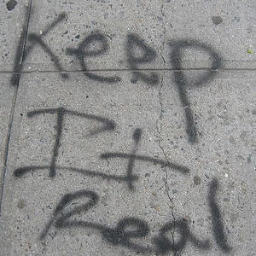
“Keep it Real”

Slide 14
Thank you for coming! Hope you see you again soon.
Contact: nsbe.cu.secretary@gmail.com
Visit us at
www.Clarksonnsbe.weebly.com

